Slide 1
Simple and scalable quality control of RNA seq experiments
Ülo Maiväli, Taavi Päll
08.06.2017
Lab seminar

Slide 2
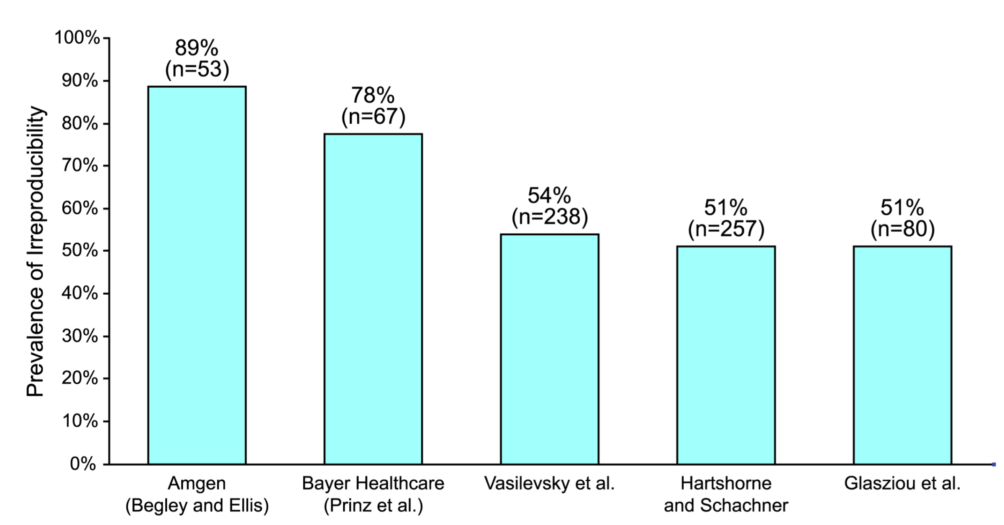
Why to measure failure?
using a conservative irreproducibility rate of 50% means that USD 28B/year is spent on research that cannot be replicated
NIH funds USD 3.7B annually on research using cell lines. A quarter of these projects use misidentified or contaminated cell lines.
PLOS Biology | DOI:10.1371/journal.pbio.1002165 June 9, 2015
Notes:
Academic research studies with potential clinical applications are typically replicated within the pharmaceutical industry before clinical studies are begun, with each study replication requiring between 3 and 24 months and between US$500,000 to US$2,000,000 investment. NIH currently funds about US$3.7B annually on research using cell lines. Given that a quarter of these research projects apparently use misidentified or contaminated cell lines,

Slide 3
Who to blame for the burning house
Bad pipetting (its all the students’ fault)
Bad experimental design (small samples – the post-doc has been lazy again)
Bad statistics (blame the statistician)
Bad bosses (uh-oh, we are all under so much pressure)

Slide 4
two traditional measures of quality
Reproducibility
Replicability

Slide 5
Your analysis is irreproducible when
the original data and/or full description of original analysis is not available or
re-running the exact same tests on original data produces different results or interpretations
Hiding the data does not necessarily mean its bad data or bad analysis – but we cannot be sure

Slide 6
Your study is not replicable when
a new sample leads to qualitatively different results
Original P = 0.01, replication P = 0.08
not replicated? Delta P = 0.07
Original P = 0.08, replication P = 0.88
replicated? Delta P = 0.8
Replication is expensive and there are no agreed on statistical methods to estimate replicability

Slide 7
tamoxifen and breast cancer survival
25 of 26 individual studies of tamoxifen’s effect were not statistically significant.
Non-significant findings could be described as having been replicated 25 times.
Yet, when pooled, a highly significant 20% reduction in mortality.
But meta-analysis assumes that you trust the integrity of original results (what if they came from the pre-selection of an underpowered, but statistically significant study?)

Slide 8
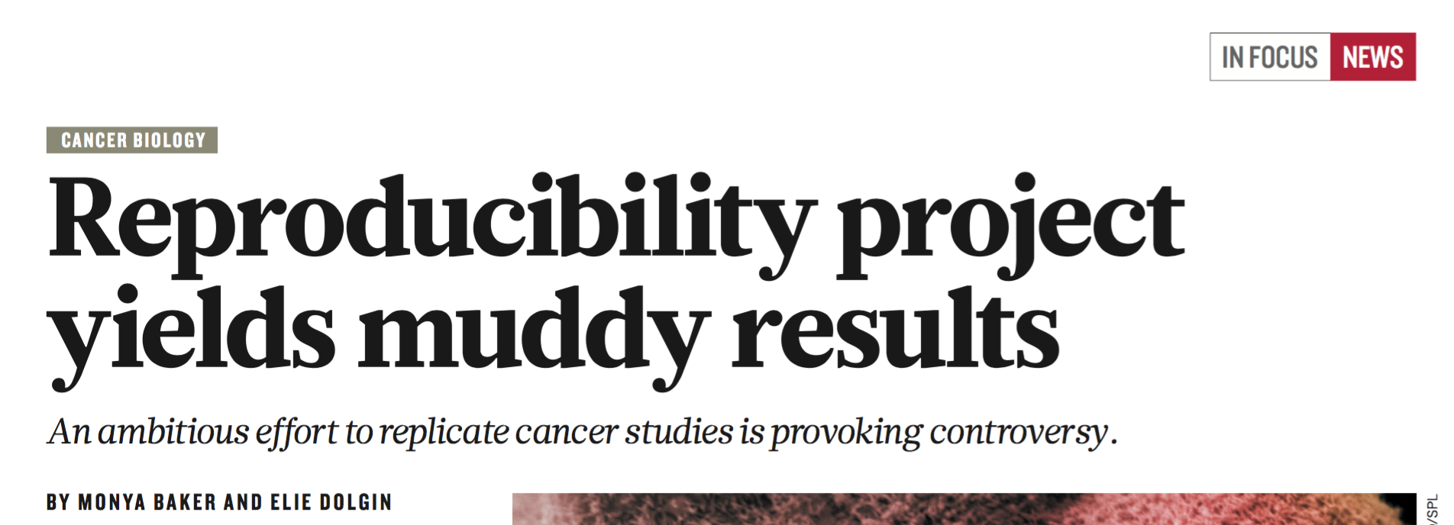
19 JANUARY 2017 | VOL 541 | NATURE | 269
launched in 2013 to scrutinize 50 papers.
In 2015 down-sized to 29 papers.
After spending USD 2 million, 5 papers done

Slide 9
The Reproducibility Project: Cancer Biology
5 papers:
1 – not reproduced
2 – reproduced
2 – failure to decide
things went wrong with tests to measure the growth of tumours. When this happened, the replication researchers were not allowed to deviate from the peer-reviewed protocols. Doing anything else would have introduced bias.
Notes:
They mistook a statistical method-specific problem for a general methodological problem. Bayesian data analysis would have allowed to change course, collect more and different data and save a lot of money! The point is that they must have been really unsure about their formal analysis of replicability, to do anything that stupid and simply walk away from their work.

Slide 10
We study a single field – gene expression profiles by RNA seq
Q1: what is the frequency of failure (conservatively)?
Q2: what is the order of the specific causes of failure?

Slide 11
Our approach
GEO database contains author-submitted raw data & p values
We use methods, which were created in the 1930-ies to assess long run quality of experimental systems, combining them with modern additions that enable us to assess the quality of single biological experiments
this only works for omic experiments that do thousands of parallel tests (each test compares the means of 2 groups of data)

Slide 12
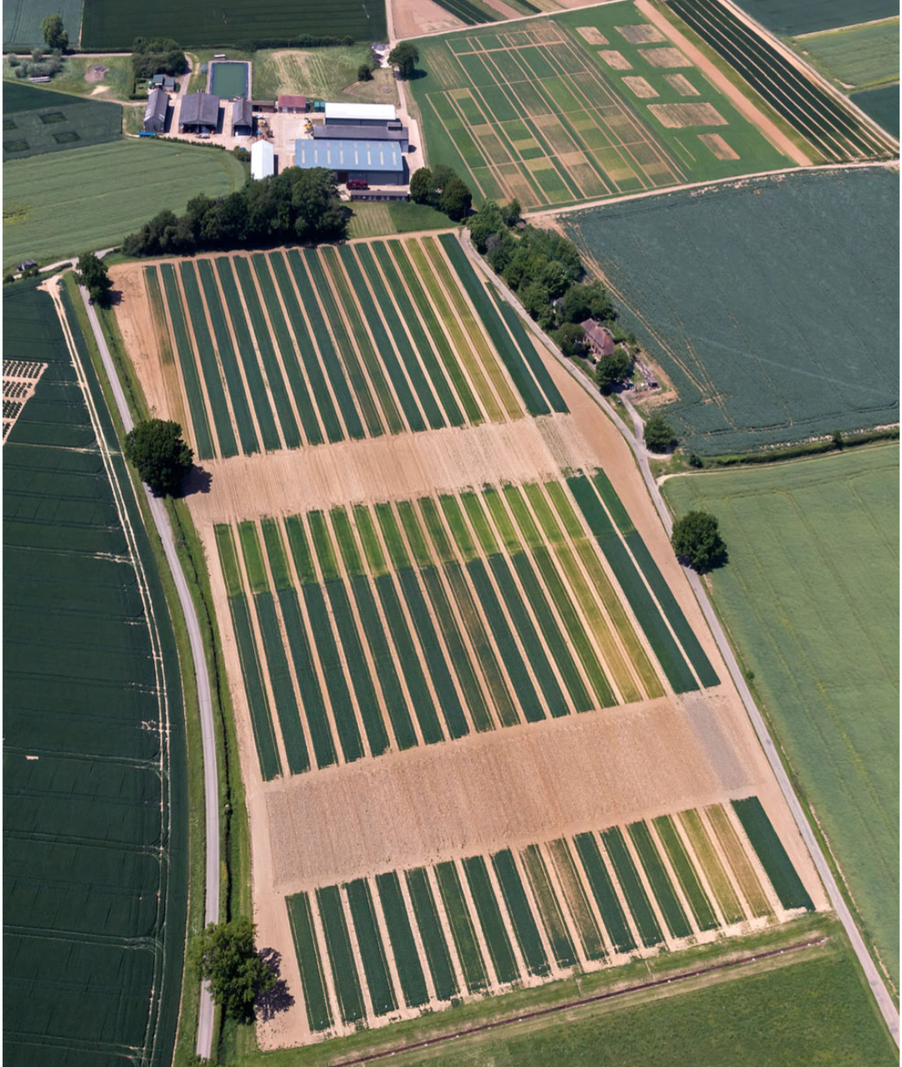
State of the art 1843 – 1919:
the longest experiment
Rothamsted research farm.
Land was divided into strips, with each strip containing a different fertilizer.
The same treatments were applied to the same strip every year, and crop yield and rainfall data were collected.
By 1919 Rothamsted had nearly 70 years of data from this unreplicated field experiment, but could not make sense out of it because of the large amount of variation within the field and the differences in yearly rainfall.
They hired R. A. Fisher
In Vitro Cell.Dev.Biol.—Plant (2016) 52:547–562
Notes:
In 1843 the owner of a factory that produced artificial fertilizers, established a research farm at his Rothamsted Estate, for the purpose of determining the effects of fertilizers.
Fisher showed that the effects of the fertilization treatments were confounded with the effects of weather, and that it was not possible to completely separate the effects of weather and fertilization. The result was nearly 70 years of planting, harvesting, and measuring for a pile of data that contained little information on the effects of different manures on crop yields. this experience caused him to turn his attention away from the data and to focus on "the process by which the data had come into existence"

Slide 13
To consult a statistician after an experiment is finished is often merely to ask him to conduct a post mortem examination. He can perhaps say what the experiment died of.
R. A. Fisher (1938)
If you do not feel competent to analyze your own data, then, almost certainly, you should not feel competent to design your own experiment

Slide 14
Fisherian statistics ca. 1923
Exp design, randomization, null hypothesis testing, p values – all created as a response to a specific agricultural experiment with high variation, medium-sized samples
Question: is there a non-random difference between different fertilizers (while ignoring the confounding effect of rainfall)
Non-negotiable computational simplicity, with any trade-off permitted. This causes inferential problems to this day.
Such methods travel poorly – today maybe 10 000 different statistical tests
Ca 1936 null-hypothesis testing was reworked to answer a different question – about long run quality of the experimental system (not about a single experiment)

Slide 15
state of the art 1935 – 1995: specificity
P value is the frequency of encountering a certain type of data, assuming that mean(group1) = mean(group2)
The operational rule:
set a significance level ⍺ (often 0.05; 1 - ⍺ = specificity)
calculate P
If P < ⍺, you have a “statistically significant” effect
This rule allows you to say that in the long run you fill falsely accept as “significant” the fraction of ⍺ null effects
“statistically significant” reads: “your data are unlikely, if there is truly null effect”
It does not read: “null effect is unlikely, given your data”
“statistically not significant” has no interpretation

Slide 16
These requirements are specific to a data analysis strategy, they are not absolute commandments
Pre-set N (stopping rules)
Random & independent samples
Pre-registration of experimental protocols
Pre-registration of statistical tests & their parameters
All because the goal is to fix the specificity at a given level

Slide 17
state of art 1937 – 2010: power
Power = the long run relative frequency of true non-null effects that are “statistically significant”
80% power means that 20% of true non-null effects will be labelled “not significant”
Power is a good true-positive rate, but it is very hard to calculate accurately
good estimates of true effect size and variation are surprisingly hard to get
Lots of power calculations in the literature are badly done
most mouse studies are severely under-powered

Slide 18
Developments since 1995: specificity
Specificity by itself is rather useless, because it ignores the frequency of true non-null effects, but it can be developed further into False Discovery Rate
FDR = false “significant” discoveries / all “significant” discoveries
With FDR there come two extras: π₀ – the frequency of true null effects, and q value
q value – the probability that your effect is true null, given the data

Slide 19
A simulated P curve
Histogram of 18 000 p values calculated from true null effects (red)
and 2 000 p values from non-null effect (blue)
Power = 0.6
⍺ = 0.05
π₀ = (C + D) / (A + B + C + D)
FDR = A / (A + C)
1 – Specificity = C / (C + D)
Power = A / (A + B)

Slide 20
What if π₀ is low?
This means that most tests measure true effects, which is incompatible with most experimental designs, and arguably with most scientific expectations as well

Slide 21
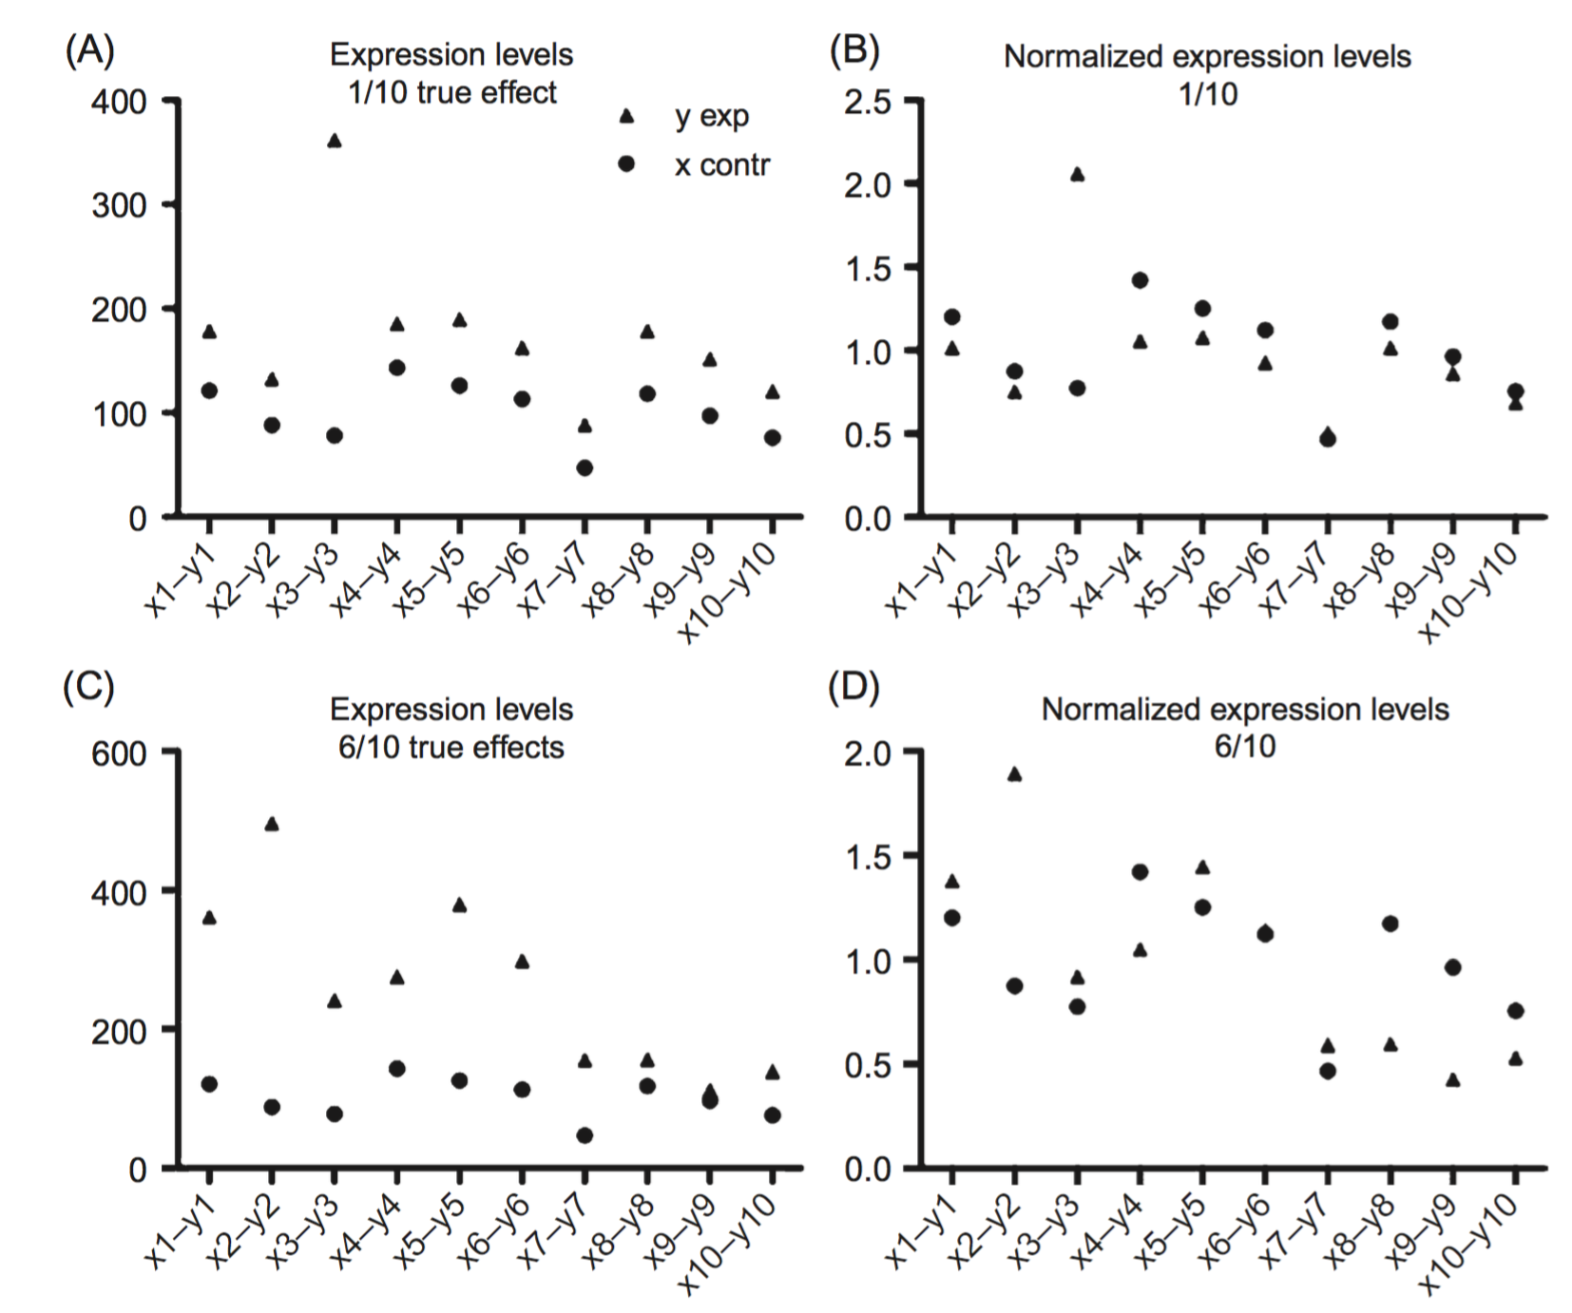

Slide 22
What if π₀ = 1
Then no true effects can be discerned from a sample of this size.
If the authors nevertheless describe them, their statistical work is gone wrong.

Slide 23
What if there are strange shapes in the true-null part of the histogram
p values were calculated wrong, any conclusions are unsupported

Slide 24
Quality filter 1:
If P distribution is flat with one spike near 0
and π₀ is between 0.7 and 0.99
Then we should expect a specific gene expression response to the experimental treatment AND we expect to find some true-positive effects from the sample that was collected

Slide 25
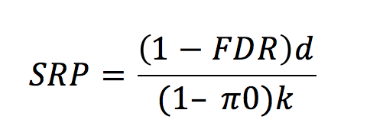
Developments since 2010: power
There are a few power estimation algorithms that generate a compatible concept with FDR, but they are all rather complicated and not in much use.
Intended for prospective power calculation
We made a simple algorithm that uses only stuff that you have from your FDR calculation anyway and gives a fully FDR-compatible retrospective power estimate
d = the number of tests, whose q < FDR
k = the total number of tests in the family

Slide 26
Power cannot be ignored …
Low power leads to
Missed true effects
inflated effect sizes for the “significant” results

Slide 27
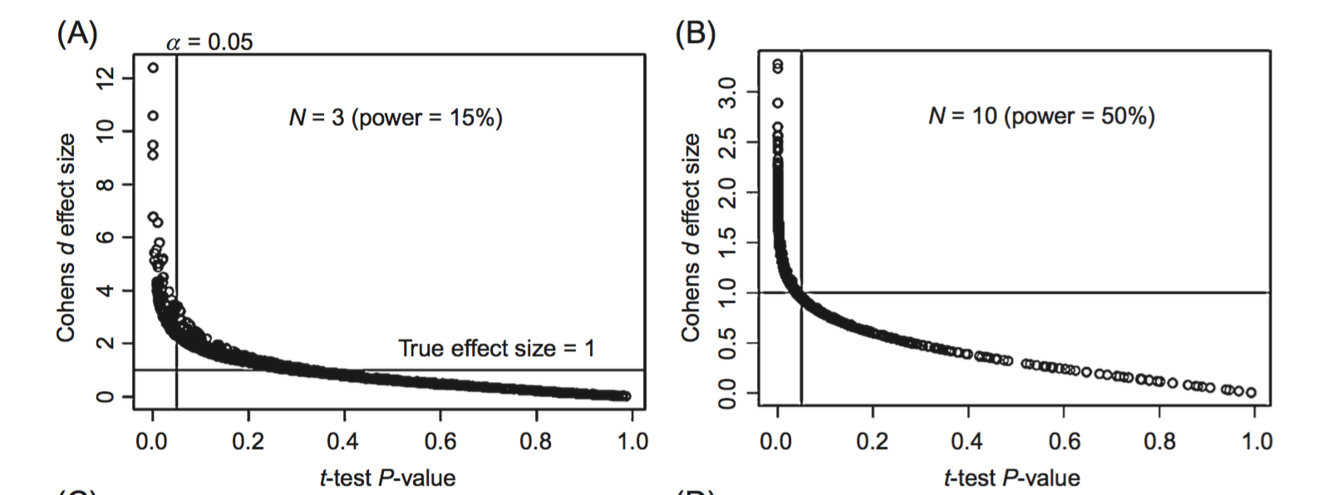
Two normally distributed populations were simulated (mean = 0, SD = 1 and mean = 1, SD = 1). From each population 1,000 samples were compared with student’s t-test. The true effect size (1.0) and the significance level (0.05) are denoted by lines.
when the power is less than 0.5 and the significance level is set at 0.05, it is very difficult not to grossly overestimate the effect size.

Slide 28
This means that if we want to assess the quality of a study, we absolutely need to estimate its power

Slide 29
Quality filter 2:
Retrospective power calculated from the sample data should be > 0.5
Otherwise, the effects in the original study are likely to be over-estimated by a factor of 2 to 10

Slide 30
tips for prospective power
doi:10.1093/bioinformatics/btu640
RNA seq power depends on the nr of reads: longer genes and higher expressed genes have higher power
Removing genes with < 10 counts increases power for the other genes
Doing more biological replicates with the same total read count increases power (more replicates, fewer reads per replicate)
For random human subjects – recommended N = 10+
For inbred mice – recommended N = 3-5

Slide 31
the things that we ask…
Is the study reproducible? | Are sufficient data available (a list of p values suffices)?
Is it replicable? | What sample size would be needed to again get most of the true effects that were “significant” in the original study?
Is the π₀ < 0.7? | If yes, probably there are errors in experimental design and/or in biological assumptions of specificity of response
π₀ = 1? | If yes, then no effects can be expected; check the original paper for their claims
Is the shape of the P histogram compatible with correct usage of statistics? | If not, any and all interpretation is unsupported by evidence
is the retrospective power < 0.5? | Low power = inflated effect sizes

Slide 32
And here are some of things that we did not ask…
Are you measuring the right thing?
Confounding?
Is your statistical question relevant to your scientific question?
How do you define your sample in terms of biological (or technical) replications?

